Slide 1
Section 5.3
The Graph of a Rational Function
Copyright © 2012 Pearson Education, Inc. Publishing as Prentice Hall.

Slide 2
Copyright © 2012 Pearson Education, Inc. Publishing as Prentice Hall.

Slide 3


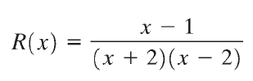


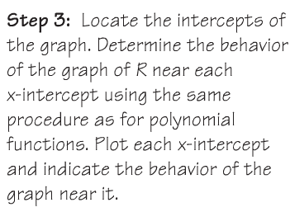

The x-intercepts are the real zeros of the numerator that are in the domain of R. x – 1 = 0 so x = 1 is the only x-intercept.
Copyright © 2012 Pearson Education, Inc. Publishing as Prentice Hall.

Slide 4
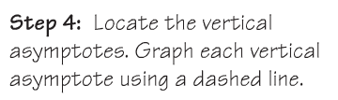
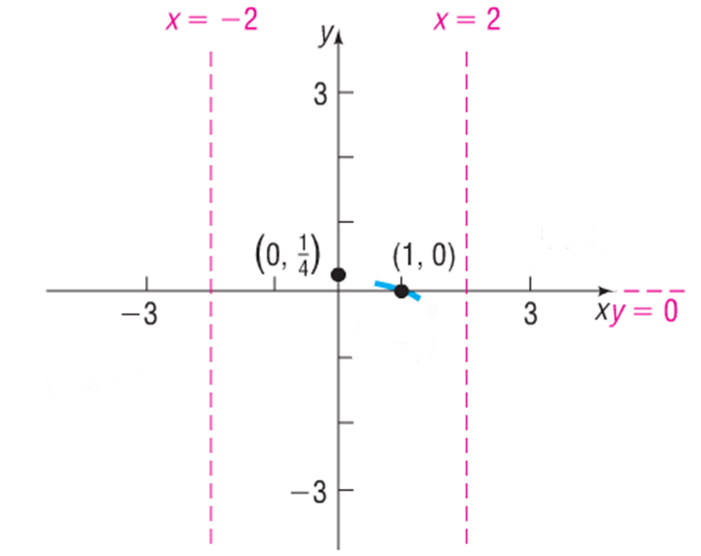
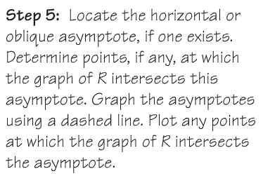
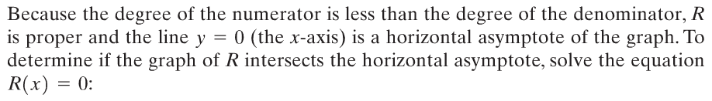
Copyright © 2012 Pearson Education, Inc. Publishing as Prentice Hall.

Slide 5
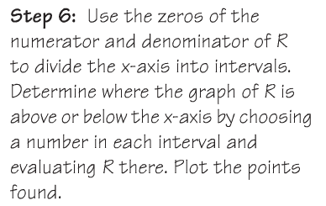
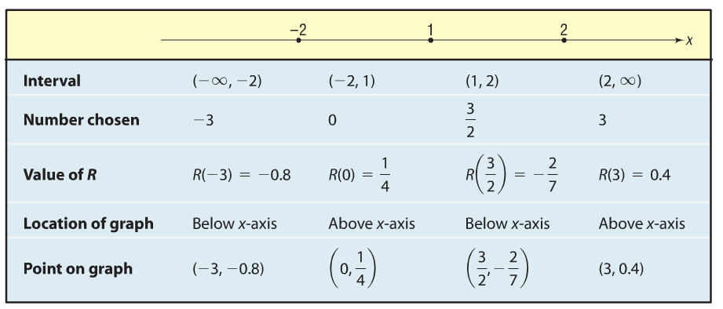
Copyright © 2012 Pearson Education, Inc. Publishing as Prentice Hall.

Slide 6
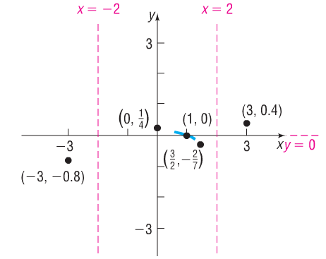
Copyright © 2012 Pearson Education, Inc. Publishing as Prentice Hall.

Slide 7
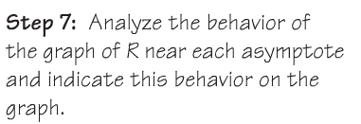
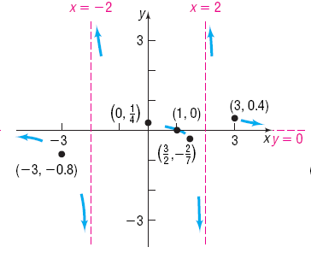
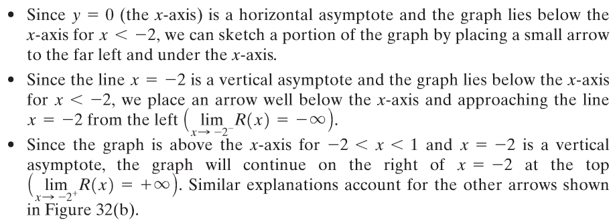
Figure 32(b)
Copyright © 2012 Pearson Education, Inc. Publishing as Prentice Hall.

Slide 8

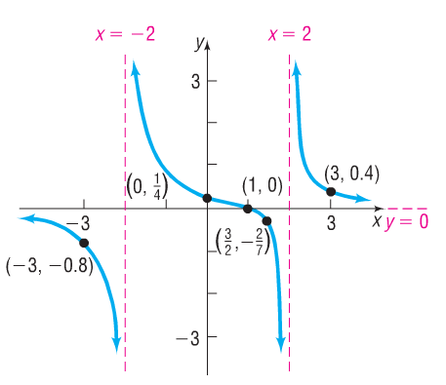
Copyright © 2012 Pearson Education, Inc. Publishing as Prentice Hall.

Slide 9



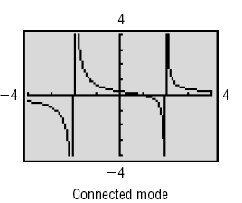
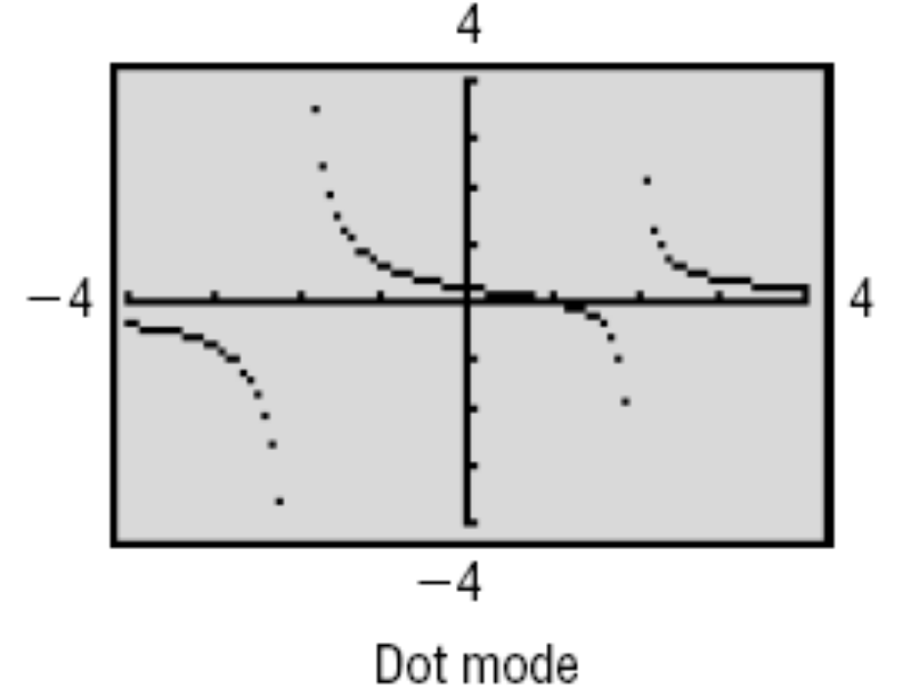
Copyright © 2012 Pearson Education, Inc. Publishing as Prentice Hall.

Slide 10
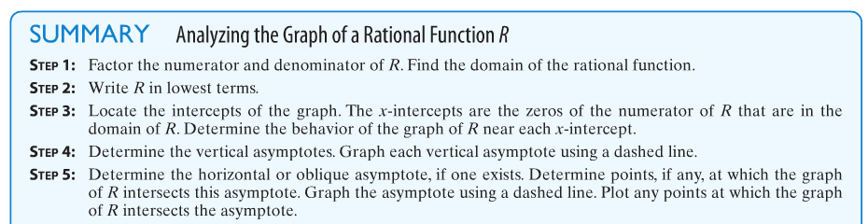
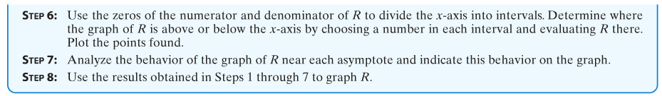
Copyright © 2012 Pearson Education, Inc. Publishing as Prentice Hall.

Slide 11

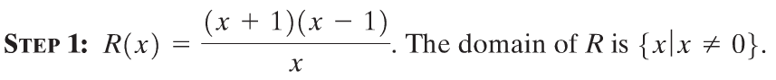

Copyright © 2012 Pearson Education, Inc. Publishing as Prentice Hall.

Slide 12
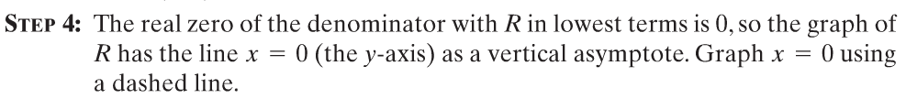
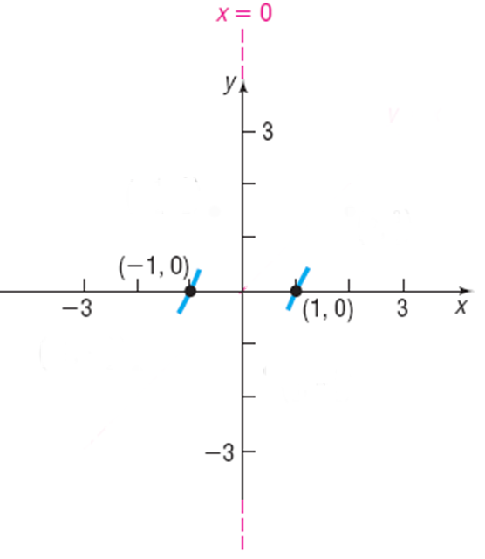
Copyright © 2012 Pearson Education, Inc. Publishing as Prentice Hall.

Slide 13
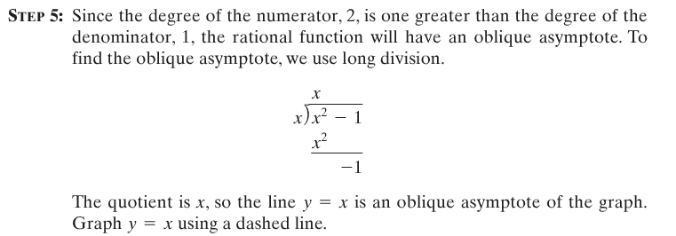
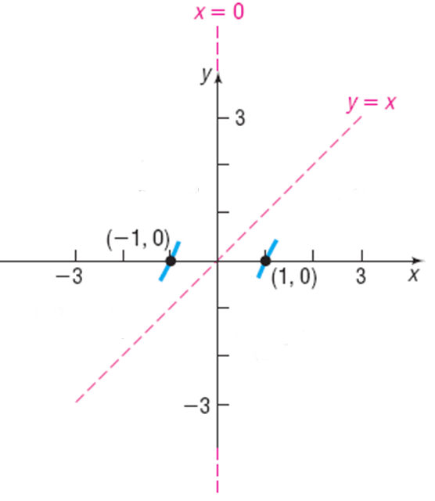
Copyright © 2012 Pearson Education, Inc. Publishing as Prentice Hall.

Slide 14
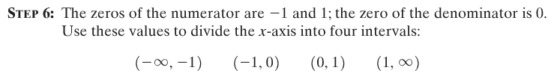
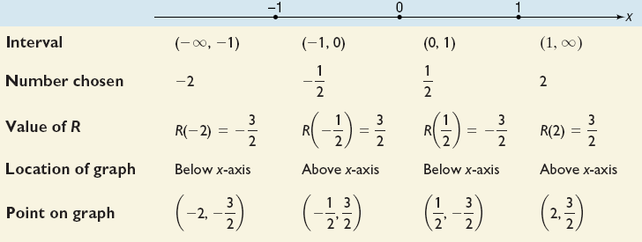
Copyright © 2012 Pearson Education, Inc. Publishing as Prentice Hall.

Slide 15
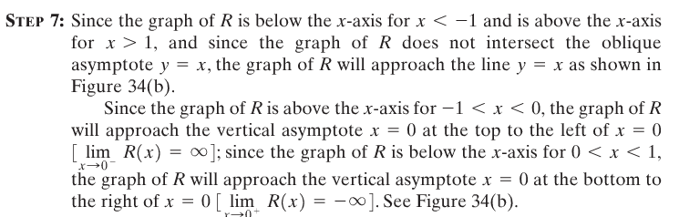
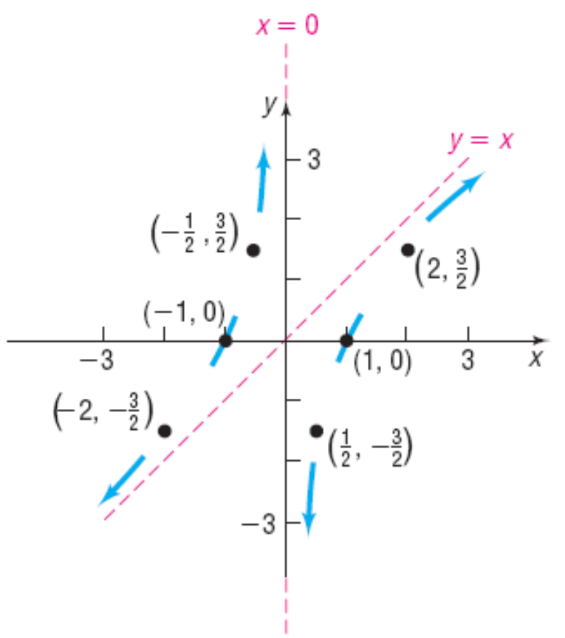
Figure 34(b)
Copyright © 2012 Pearson Education, Inc. Publishing as Prentice Hall.

Slide 16
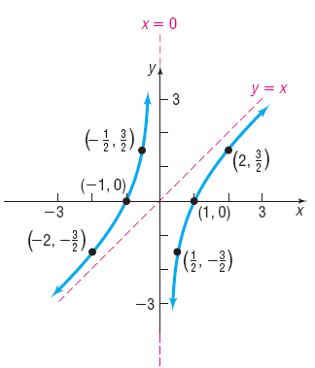
Figure 34(c)
Copyright © 2012 Pearson Education, Inc. Publishing as Prentice Hall.

Slide 17
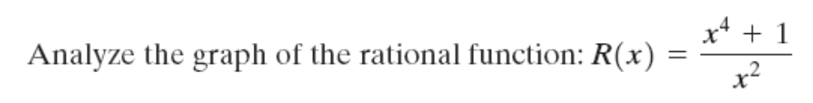

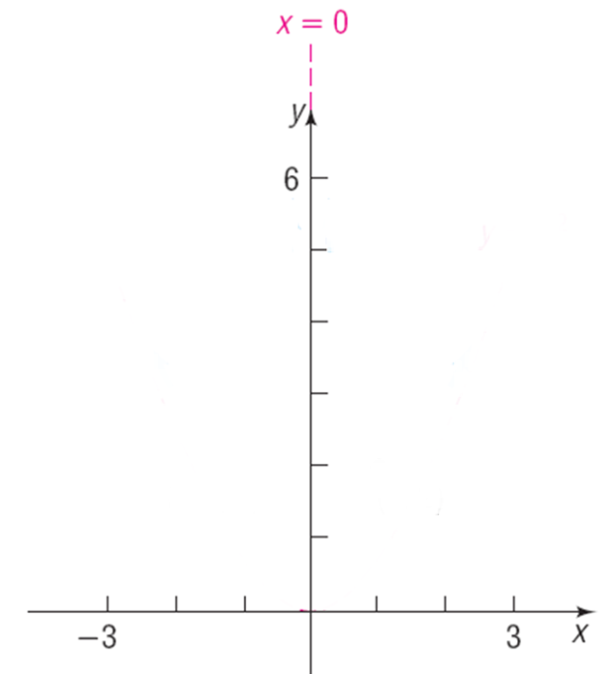
Copyright © 2012 Pearson Education, Inc. Publishing as Prentice Hall.

Slide 18
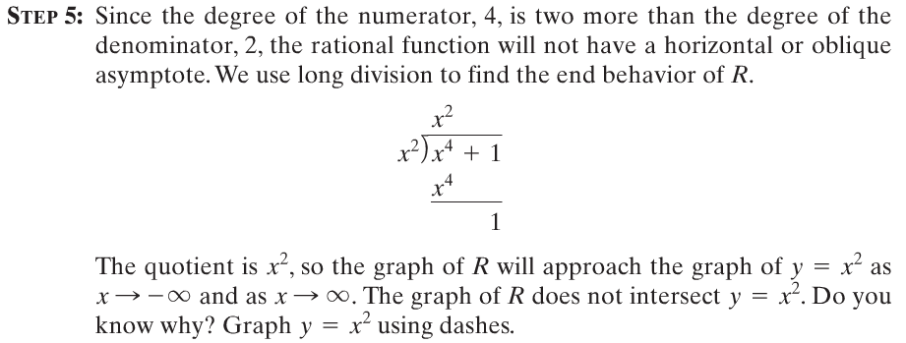
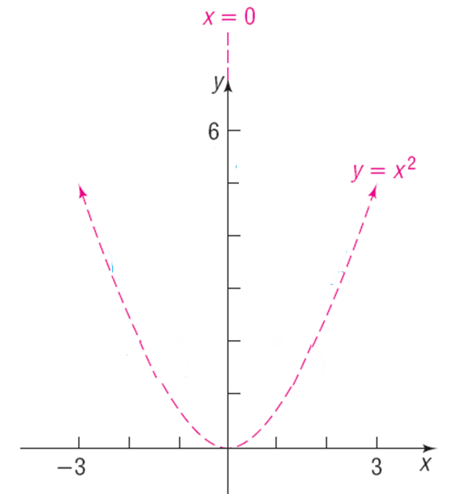
Copyright © 2012 Pearson Education, Inc. Publishing as Prentice Hall.

Slide 19
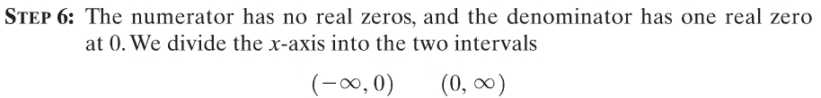
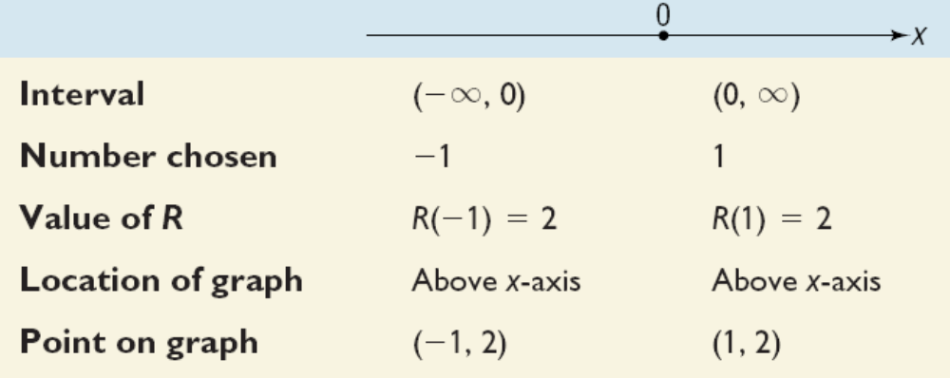
Copyright © 2012 Pearson Education, Inc. Publishing as Prentice Hall.

Slide 20
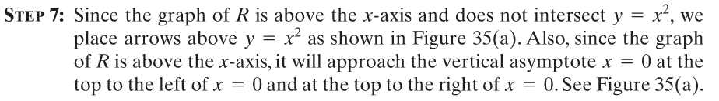
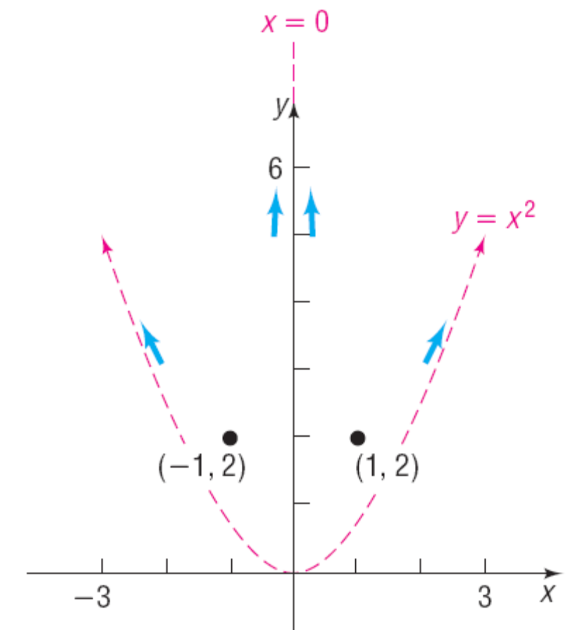
Figure 35(a)
Copyright © 2012 Pearson Education, Inc. Publishing as Prentice Hall.

Slide 21
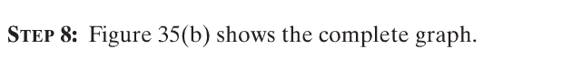
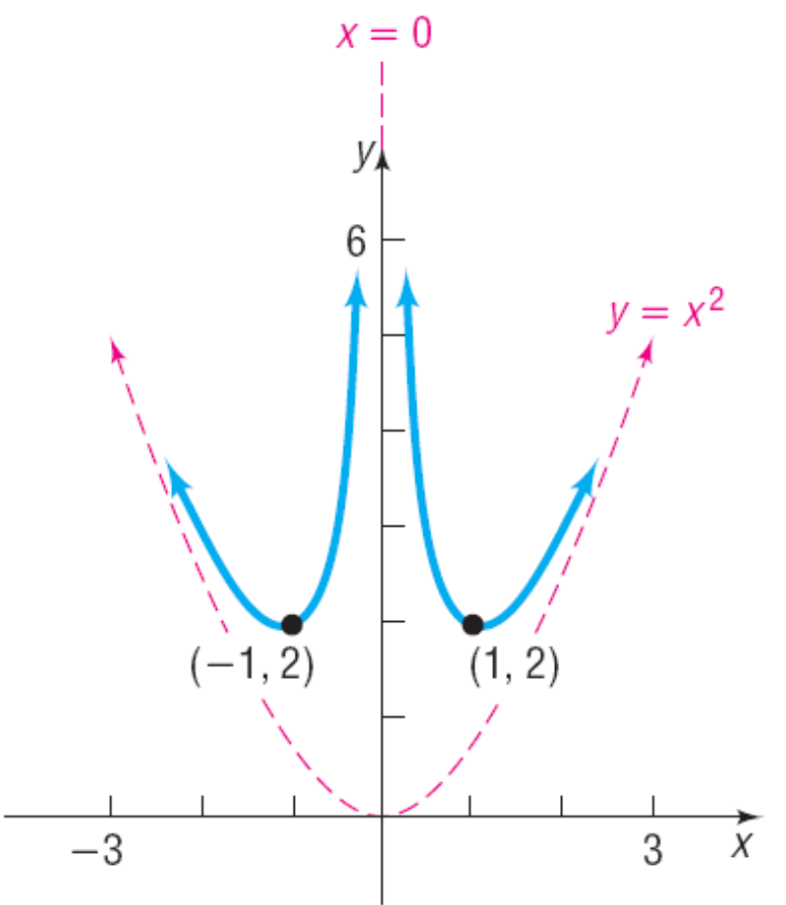
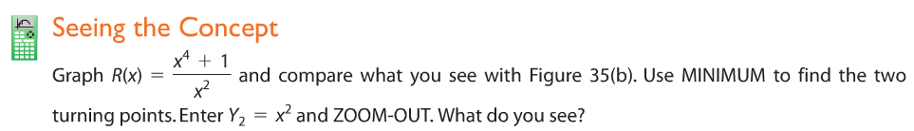
Figure 35(b)
Copyright © 2012 Pearson Education, Inc. Publishing as Prentice Hall.

Slide 22




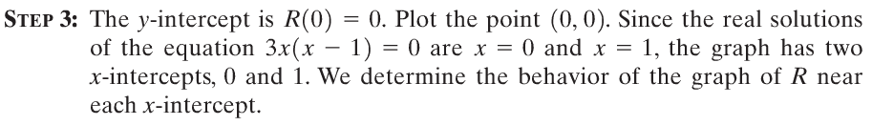


Copyright © 2012 Pearson Education, Inc. Publishing as Prentice Hall.

Slide 23

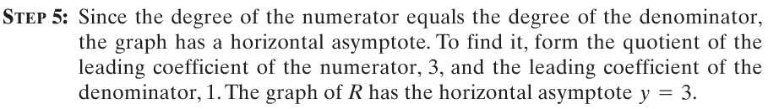
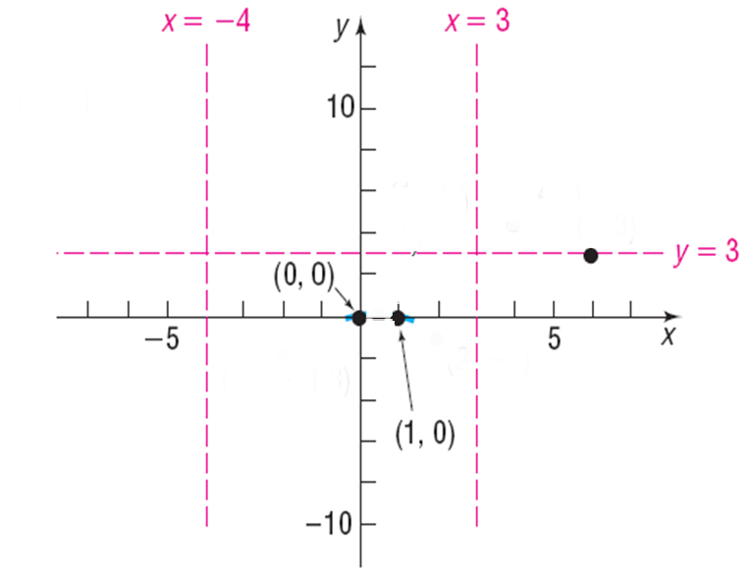
Copyright © 2012 Pearson Education, Inc. Publishing as Prentice Hall.

Slide 24
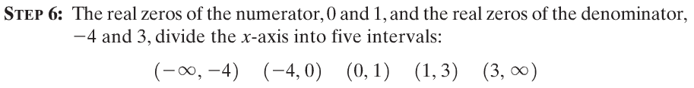
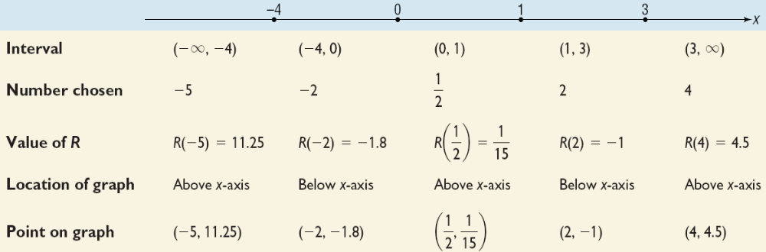
Copyright © 2012 Pearson Education, Inc. Publishing as Prentice Hall.

Slide 25
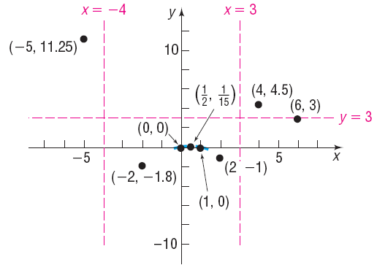
Copyright © 2012 Pearson Education, Inc. Publishing as Prentice Hall.

Slide 26
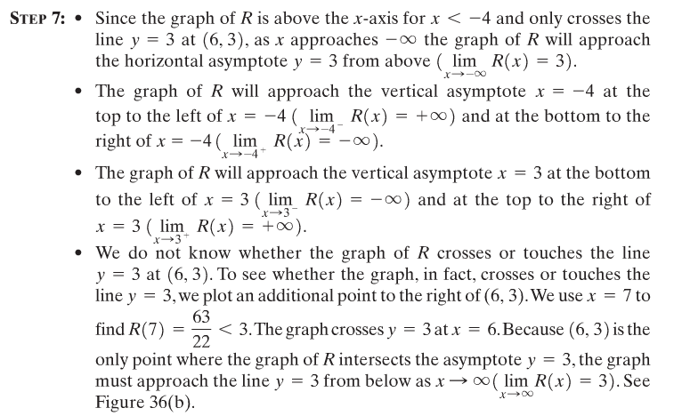
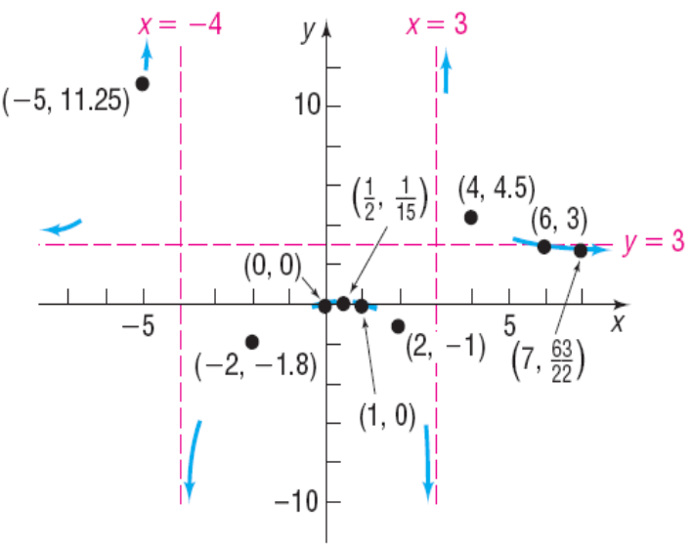
Copyright © 2012 Pearson Education, Inc. Publishing as Prentice Hall.

Slide 27
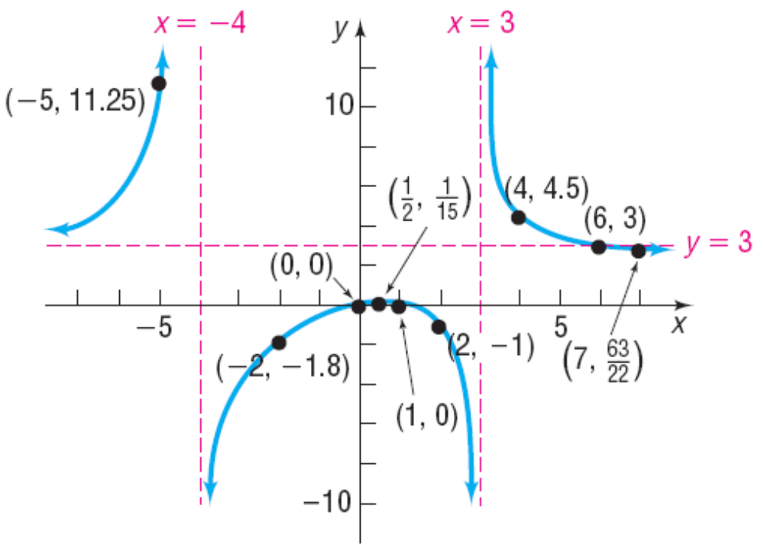
Copyright © 2012 Pearson Education, Inc. Publishing as Prentice Hall.

Slide 28
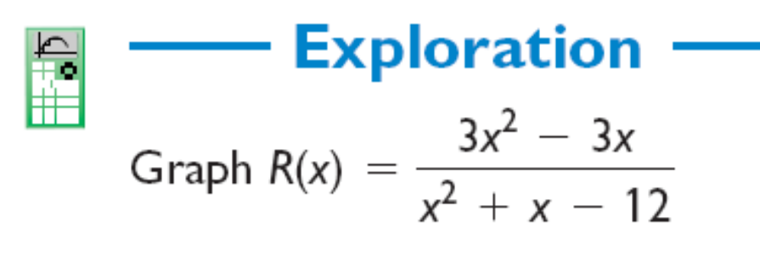
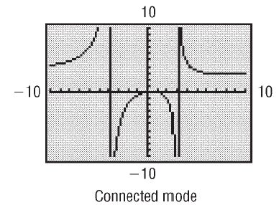
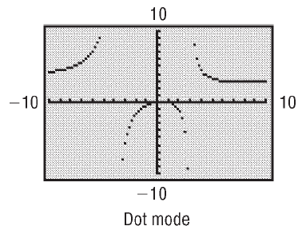

Copyright © 2012 Pearson Education, Inc. Publishing as Prentice Hall.

Slide 29

Copyright © 2012 Pearson Education, Inc. Publishing as Prentice Hall.

Slide 30







Copyright © 2012 Pearson Education, Inc. Publishing as Prentice Hall.

Slide 31



Copyright © 2012 Pearson Education, Inc. Publishing as Prentice Hall.

Slide 32


Copyright © 2012 Pearson Education, Inc. Publishing as Prentice Hall.

Slide 33


Figure 40(a)
Copyright © 2012 Pearson Education, Inc. Publishing as Prentice Hall.

Slide 34


Figure 40(b)
Copyright © 2012 Pearson Education, Inc. Publishing as Prentice Hall.

Slide 35

Copyright © 2012 Pearson Education, Inc. Publishing as Prentice Hall.

Slide 36




x-intercepts are –2 (even multiplicity) and 5 (odd multiplicity)
Vertical asymptotes at x = –5 and x = 2.
Copyright © 2012 Pearson Education, Inc. Publishing as Prentice Hall.

Slide 37


So far we have:
Figure 41
Copyright © 2012 Pearson Education, Inc. Publishing as Prentice Hall.

Slide 38
Copyright © 2012 Pearson Education, Inc. Publishing as Prentice Hall.

Slide 39





Copyright © 2012 Pearson Education, Inc. Publishing as Prentice Hall.

Slide 40




Copyright © 2012 Pearson Education, Inc. Publishing as Prentice Hall.

Slide 41


Copyright © 2012 Pearson Education, Inc. Publishing as Prentice Hall.

